Slide 1
POLITICAL & CONSTITUTIONAL DEVELOPMENT OF PAKISTAN (1947-69)

Slide 2
Liaquat Years (1948 – 1951)
Khwaja Nazimuddin Appointed as 2nd GG
PRODA
Objectives Resolution
Basic Principles Committee (BPC)
Liaquat-Nehru Pact
Assassination of Liaquat

Slide 3
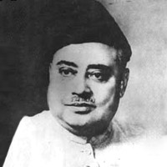
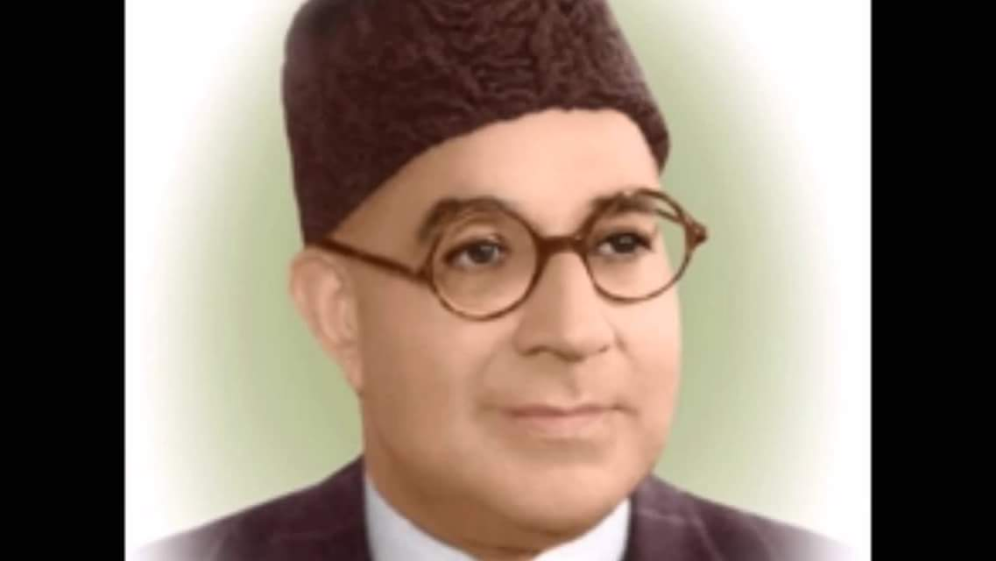
Liaquat Years (September 1948 – October 1951)
After Pakistan came into being on August 14, 1947, Nazimuddin was appointed the first Chief Minister of the Province of East Bengal. When the founder of Pakistan, Quaid-i-Azam, Muhammad Ali Jinnah died on September 11, 1948, Nazimuddin was appointed as the second Governor General of Pakistan.
Public and Representative Office Disqualification Act (PRODA)
In 1949 the PRODA allowed the government to disqualify persons found guilty of "misconduct," a term that acquired a broad definition.
PRODA act showed that PAKISTAN had yet to become the free, democratic country. By this act complaints could be made to the governor general or provincial governors who could order an enquiry by judges. Anyone found guilty under PRODA was debarred from office. The law was designed to eliminate corruption, but in reality, it allowed the ruling elite to remove those who it did not approve of.

Slide 4
First Constituent Assembly (1947-54)
The first Constituent Assembly came into existence under Indian Independence Act 1947.
The elections were held in July 1946 to decide the destiny of the All India Muslim League (AIML)’s claim that it is the only representative party of the Indian Muslims that desire separate homeland, Pakistan. The members from the districts that became part of Pakistan were declared members of the Constituent Assembly. The number of such members was 69. It increased to 79 after the 1947 when some states joined Pakistan and then increase in the population.
There were two major parties, Muslim League and Congress in the Assembly at that time. This Assembly had dual functions to perform.

Slide 5
Objectives Resolution (1949)
The Objectives Resolution was the first constitutional document that proved to be the ‘foundation’ of the constitutional developments in Pakistan. It provided parameters and sublime principles to the legislators. It made the constitution-making process easy task setting some particular objectives before them that would be acceptable to the people of Pakistan who had suffered a lot under the Hindu-dominated majority. The Resolution was moved by Liaquat Ali Khan, the then Prime Minister of the Islamic Republic of Pakistan, and approved on March 12, 1949.

Slide 6
Objectives Resolution (1949)
The objectives resolution presented:
“Sovereignty over the entire universe belongs to God Almighty alone, and the authority which He has delegated to the State of Pakistan through its people for being exercised within the limits prescribed by Him as a sacred trust”.

Slide 7
Objectives Resolution (1949)
Features of the Objectives Resolution
Sovereignty over the entire universe belongs to Almighty Allah alone.
The authority which He has delegated to the state of Pakistan through its people for being exercised within the limits prescribed by Him is a sacred trust.
Constitution will be framed for sovereign, independent state of Pakistan.
The state shall exercise its power through the representatives of the people.
Principles of Democracy, freedom, equality, tolerance and social justice as enunciated by Islam will be fully observed.
Muslims shall be enabled to organize their lives in accordance with the teachings and requirements of Islam as set out in the Quran and the Sunnah.
Minorities to have freedom to freely profess and practice their religions and develop their cultures.
Provisions for safeguarding the legitimate interests of minorities, backward and depressed classes.
Pakistan shall be a Federation with autonomous units. State’s sovereignty and territorial integrity will be protected.
People of Pakistan should prosper and attain their rightful place in the comity of nations and make contribution towards international peace and progress and happiness of humanity.

Slide 8
Objectives Resolution (1949)
Objections by Non-Muslims:
The major objection by the Non-Muslims was that the government was trying to mix the religion and politics that was against the spirit of democracy. The non-Muslims objected on the ‘Sovereignty of Allah’ and minorities’ rights, saying it would promote inequality in the society. They were also of view that Shariah was not adequate for the modern time. They feared that it would encourage the religious extremists to work for the establishment of a ‘theocratic state.’
Importance:
The Objectives Resolution is a basic and primary document of the constitutional history of Pakistan. It is a framework that provides mechanism to achieve goals for a better life of the people of Pakistan. It’s important that it embraces centrality of Islam to polity sustaining their links with the pre-independence period. The AIML leaders were modernist Muslims not in favour of an orthodox religious state. Therefore, they selected the middle way abiding by the Islamic laws and the international democratic values. The Resolution remained ‘Preamble of all the constitutions due to its importance.

Slide 9
Basic Principles Committee
After the Objectives Resolution was passed in 1949, the Constitution Assembly set up a number of committees to draw the future constitution on the basis of the principles given in the Objectives Resolution. The most important among those committees was the Basic Principles Committee set up on March 12, 1949, by Khawaja Nazimuddin on the advice of Prime Minister Liaquat Ali Khan.
The main function of this committee was to determine the basic principles of the future Constitution of Pakistan. The committee comprised 24 members. Maulvi Tamiz-ud-din Khan headed it and Liaquat Ali Khan was its Vice President. The committee presented its interim report to the Legislative Assembly in 1950. This was a short document presenting the guidelines and principles of the future Constitution of Pakistan.
Representatives of East Pakistan raised objections against the report. The main criticism was against the quantum representation in the Central Legislature. East Pakistan, with a majority of the population, was given an equal number of seats in the Upper House as West Pakistan, thus reducing the representation of the majority of the population in Pakistan by one-fifth. East Pakistan representatives also did not like Urdu being declared as the only national language of Pakistan

Slide 10
Basic Principles Committee
Liaquat Ali Khan agreed to consider the objections with an open mind. He, therefore, postponed the deliberation of the Constituent Assembly in order to enable the Basic Principles Committee to examine and consider suggestions that might be made by the people regarding the principles of the Constitution. In order to include public opinion, Liaquat Ali Khan called forth general comments and suggestions by the public on the report. A large number of proposals and suggestions were sent by the public, which were examined by a special subcommittee headed by Sardar Abdur Rab Nishtar. The setting up of the committee was a right and commendable step, but its working was immensely affected by the assassination of Liaquat Ali Khan.

Slide 11
Basic Principles Committee
There was to be a High Court for each of the units of East Pakistan, Punjab, Sindh Baluchistan and the N. W. F. P. A Board of Ulema was to be set up by the head of state and provincial governors. The Board of Ulema was to examine the law making process to ensure that no law was passed that went against the principles of the Quran and Sunnah. The Objectives Resolution was adopted as a preamble to the proposed Constitution.
The Basic Principles Committee’s report was severely criticized and raised much bitterness between East and West Pakistan. The Prime Minister, Khawaja Nazimuddin, however, welcomed the report and commended it as a valuable document according to the aspirations of the people of Pakistan. But the fact was that the nation was not satisfied with the report and hence there was a serious deadlock in making of the constitution.

Slide 12
Liaquat-Nehru Pact (1950)
The two Prime Ministers met in Delhi on April 2, 1950, and discussed the matter in detail. The meeting lasted for six long days. On April 8, the two leaders signed an agreement, which was later entitled as Liaquat-Nehru Pact. This pact provided a ‘bill of rights’ for the minorities of India and Pakistan. Its aim was to address the following three issues:
To alleviate the fears of the religious minorities on both sides.
To elevate communal peace.
To create an atmosphere in which the two countries could resolve their other differences.
According to the agreement, the governments of India and Pakistan solemnly agreed that each shall ensure, to the minorities throughout its territories, complete equality of citizenship, irrespective of religion; a full sense of security in respect of life, culture, property and personal honor.

Slide 13
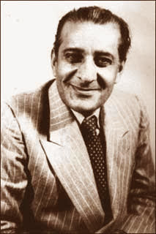
Malik Ghulam Muhammad Years (1951 – 1955)
Malik Ghulam Muhammad Appointed as 3rd GG
Dismissal of Khwaja Nazimuddin
Pakistan as the part of SEATO & CENTO
Ammendment Act of 1954
Dissolution of First Constituent Assembly
Molvi Tamizuddin Case

Slide 14
Dismissal of Khwaja Nazimuddin
Anti Ahmadiya riots and food shortages.
Ghulam Muhammad with the support of bureaucracy and military leadership used the discretionary power given to him by the provisional constitution and dismissed Nazimuddin.

Slide 15
Dismissal of Khwaja Nazimuddin
Anti Ahmadiya riots and food shortages.
Ghulam Muhammad with the support of bureaucracy and military leadership used the discretionary power given to him by the provisional constitution and dismissed Nazimuddin.

Slide 16
1955-1958 Second Constituent Assembly
One Unit Scheme
Constitution of 1956
Political Instability and Imposition of Martial Martial Law
1958-1969
Basic Democracy System Constitution of 1962
War of 1965
Fall of Ayub Khan

Slide 17
Conclusions

